Slide 1
UE20CS302: Machine Intelligence
Project Title : FAKE NEWS DETECTION USING MACHINE LEARNING ALGORITHMS
PROFESSOR-IN-CHARGE: Dr. Preethi P
TEAM MEMEBERS : SANJANA V HERUR (PES1UG20CS684)
SHALINI M (PES1UG20CS688)
VANSHIKA JAIN (PES1UG20CS698)

Slide 2
FAKE NEWS DETECTION USING MACHINE LEARNING ALGORITHMS
Abstract and Scope
Categorizing a news statement as a ‘real news’ or ‘fake news’ using machine learning techniques. The classification is a binary one.
The spread of fake news and misinformation is causing serious problems to society, partly due to the fact that more and more people only read headlines or highlights of news assuming that everything is reliable, instead of carefully analyzing whether it can contain distorted or false information. The authenticity of Information has become a longstanding issue affecting businesses and society, both for printed and digital media.
In this Project, we will use various natural language processing techniques and machine learning algorithms to classify fake news articles using sci-kit libraries from Python with maximum accuracy using just the headline of the news.
We will create a simple frontend containing search bar for typing headline and result tells if its fake or real based on chosen candidate classifier model trained on a dataset.

Slide 3
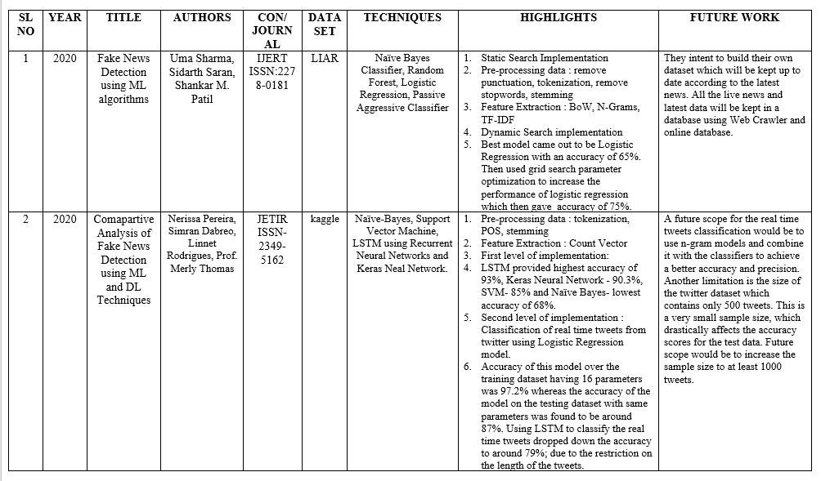
Literature Survey

Slide 4
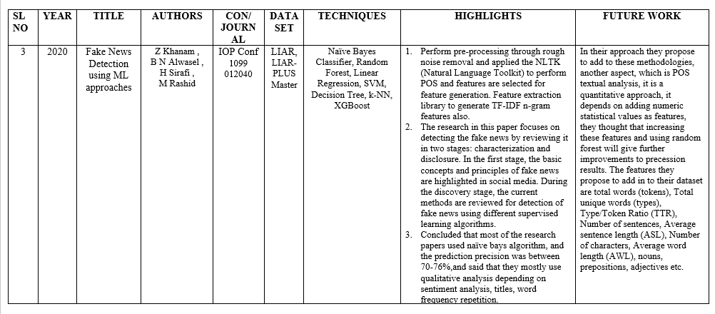
Literature Survey

Slide 5
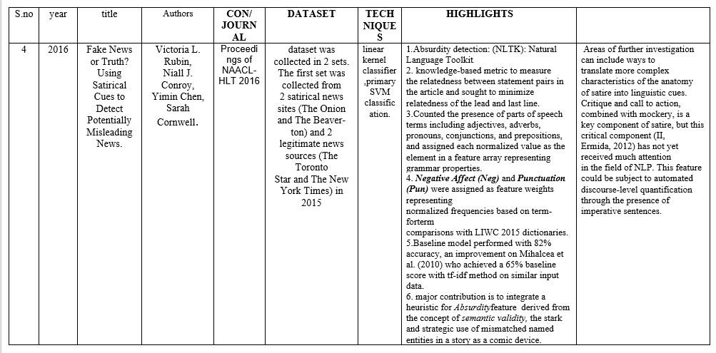
Literature Survey

Slide 6
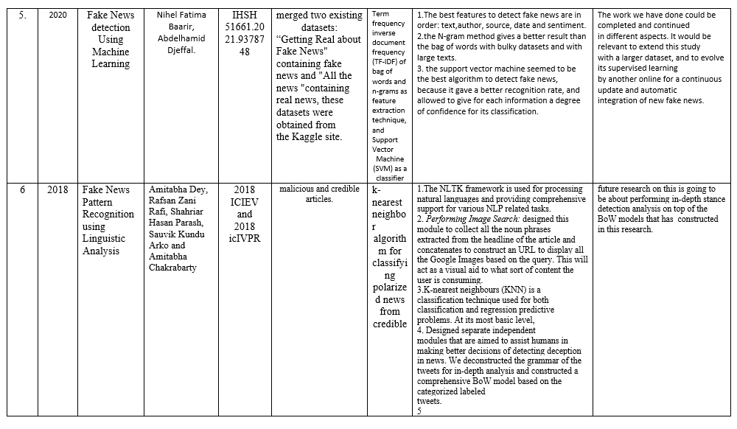
Literature Survey

Slide 7
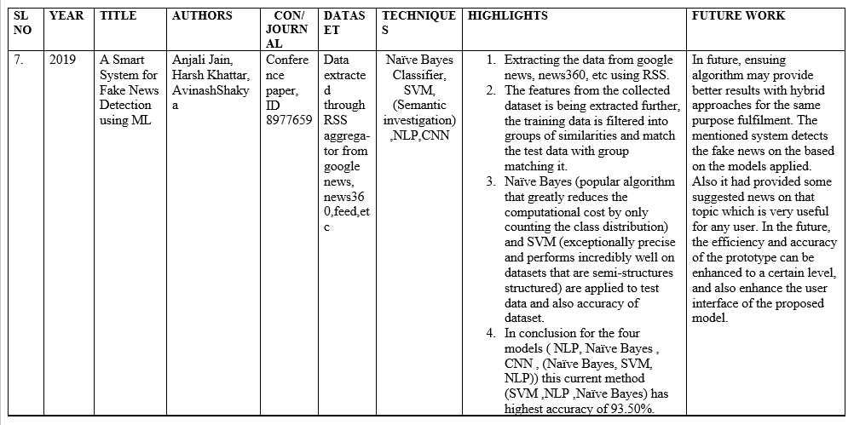
Literature Survey

Slide 8
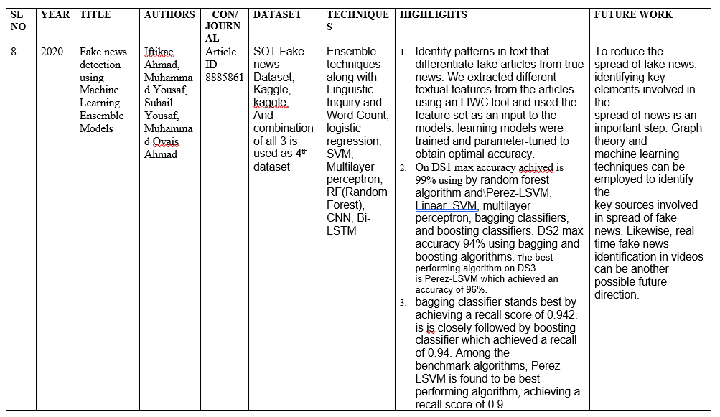
Literature Survey

Slide 9
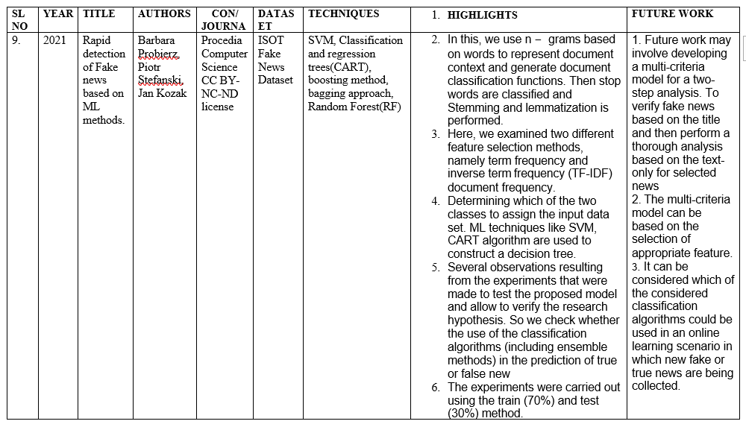
Literature Survey

Slide 10
Design Approach
Modules Used
Logistic Regression :-
It is a classification not a regression algorithm. Logistic regression is easier to implement, interpret, and very efficient to train.
It is very fast at classifying unknown records. Good accuracy for many simple data sets and it performs well when the dataset is linearly separable. The major limitation of Logistic Regression is the assumption of linearity between the dependent variable and the independent variables. It constructs linear boundaries.
Naïve bayes classifier:- It is simple and easy to implement. It doesn’t require as much training data.It handles both continuous and discrete data. This algorithm faces the ‘zero-frequency problem’ where it assigns zero probability to a categorical variable whose category in the test data set wasn’t available in the training dataset. It would be best if you used a smoothing technique to overcome this issue. Its estimations can be wrong in some cases, so you shouldn’t take its probability outputs very seriously.
SVM:-The goal of the SVM algorithm is to create the best line or decision boundary that can segregate n-dimensional space into classes so that we can easily put the new data point in the correct category in the future. This best decision boundary is called a hyperplane. SVM chooses the extreme points/vectors that help in creating the hyperplane. These extreme cases are called as support vectors, and hence algorithm is termed as Support Vector Machine.
LSTM:-Long Short-Term Memory networks (LSTM) are a special type of RNN competent in learning long-term dependencies . LSTM is a very effective solution for addressing the vanishing gradient problem. Pre-trained GloVe word embeddings are used to deal with the high dimensional news articles.

Slide 11
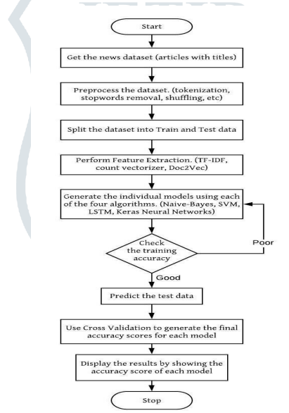
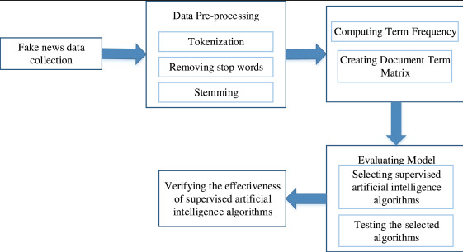
Architecture
Provide high-level design view of the system.

Slide 12
Technologies Used
What technologies you plan to use and why
Numpy: library for python programming language,adding support for large,multi-dimensional arrays and metrices,along with large collection of high level mathematical functions to operate on these arrays.
Pandas:For data manipulation and analysis
Sklearn:It contains a lot of efficient tools for machine learning and statistical modeling including classification, regression, clustering and dimensionality reduction. Python scikit-learn library to perform tokenization and feature extraction of text data, because this library contains useful tools like Count Vectorizer and Tiff Vectorizer.
Matplotlib:For creating interactive visualisations(for observing co-relatinos)
Nltk:is a Python package that you can use for NLP
Seaborn:visualisation tool based on matplotlib.

Slide 13
Project Demo
Designed Pseudocode/Algorithm can be explained.
The Dataset going to be used is LIAR dataset. Steps of implementation of project:
Preprocessing data by data cleaning. This involves removing punctuation, tokenization, remove stopwords, stemming.
Feature Generation : We can use text data to generate a number of features like word count, frequency of large words, frequency of unique words, n-grams etc. By creating a representation of words that capture their meanings, semantic relationships, and numerous types of context they are used in, we can enable computer to understand text and perform Clustering, Classification etc.
Training Using algorithms : Naïve Bayes Classifier, Random Forest, Logistic Regression, SVM, Passive Aggressive Classifier.
After fitting all classifiers, select best performing model as candidate one (based on classification report) for fake news detection.

Slide 14
References
Fake News Detection Using Machine Learning Approaches
To cite this article: Z Khanam et al 2021 IOP Conf. Ser.: Mater. Sci. Eng. 1099 012040
ISSN: 2278-0181 Published by, www.ijert.org, NTASU - 2020 Conference Proceedings
A smart System for Fake News Detection Using Machine Learning Conference Paper · September 2019DOI: 10.1109/ICICT46931.2019.8977659
Fake News Detection Using Machine Learning Ensemble Methods Iftikhar Ahmad , 1 Muhammad Yousaf, 1 Suhail Yousaf , 1 and Muhammad Ovais Ahmad
Rapid detection of fake news based on machine learning methods Barbara Probierza,∗, Piotr Stefa ́nski a , Jan Kozak
Fake News Pattern Recognition using Linguistic Analysis :Amitabha Dey, Rafsan Zani Rafi, Shahriar Hasan Parash, Sauvik Kundu Arko and Amitabha Chakrabarty
Comparative Analysis of Fake News Detection using Machine Learning and Deep Learning Techniques.: Nerissa Pereira, 2Simran Dabreo, 3Linnet Rodrigues, 4Prof. Merly Thomas

Slide 15
Thank You

